Slide 1
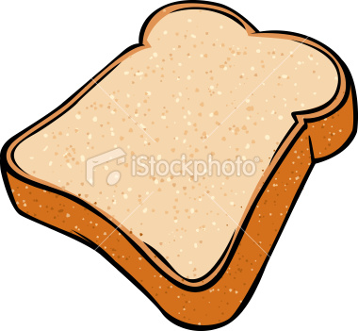
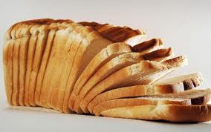
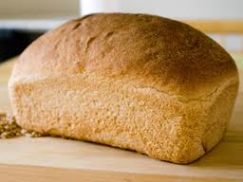
curve f(x,y),
where y fixed
area of cross- section
Iterated integral
volume
of
volume
of
volume
of
Iterated integral
http://calculus7.com/id34.html

